Slide 1
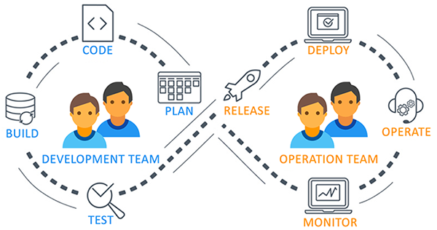
Azure DevOps
Azure DevOps, a modern DevOps tool of planning, developing, testing and deploying modern apps.
Azure DevOps services are not dependent on cloud or platform.
Azure DevOps has various options for tool and cloud service selection as per the requirement
Azure DevOps includes Git repositories as source control, build and release management tools, work planning and tracking tools, testing tools and support services like Slack, Trello and Azure services.
Azure DevOps provides a tool which can help you to track software building progress and help you to take decision to deliver great software to end users.

Slide 2
Azure DevOps Services Vs. Server
Azure DevOps comes with two options:
Azure DevOps Services
Azure DevOps Server
Both the services and the server were known as Visual Studio Team Services (VSTS) and Team Foundation Server (TFS), respectively. They provide environments that support Git, Agile tools, and continuous integration. Let us see the differences between them:
Azure DevOps Services | Azure DevOps Server
It is a cloud offering. | It is an on-premise offering.
It offers two options for scaling and scoping data: organizations and projects. | It offers three options for scaling and scoping data: deployment, project collections, and projects.
You can connect over the public network. | You can connect to the intranet server.
The access level must be assigned to each user. | Access levels must be set based on the license.

Slide 3
Azure DevOps Benefits
Reliability: Azure DevOps is reliable, scalable, and globally available.
Accessibility: Azure DevOps users get access to new features every 3 weeks. Microsoft is transparent.
Flexibility: If your DevOps team doesn’t want or need the full suite of services, they can acquire them independently.
End of upgrade cycle: For organizations running on-premises CI/CD tooling, upgrading is difficult. By SaaS, it is an easy task.
Continuous Integration & Continuous Delivery (CI - CD)
When the code is committed, it automatically builds and is tested for errors, enabling bugs detection early. Business organizations can achieve fast and identical deployment to the production environment at any given time.
Automation Testing
The use of automated tests, such as security and compliance tests identify problems at the testing phase. We can quickly provision resources and configures the entire production environment in a quick time.
Any Platform, Any Language
It supports various platforms and a runs on multiple frameworks. The developers using Java, Node, PHP, .NET, and Python can efficiently work on it.

Slide 4
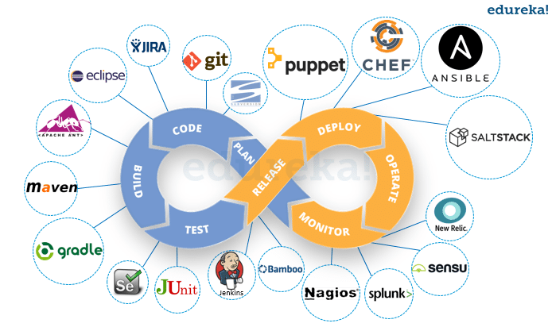
Tools for Azure DevOps
Azure DevOps works well with most of the DevOps tools.
Category | Tools Name
Configuration Tools | Chef, Ansible, Puppet
Continuous Integration | Jenkins
Microservices | Docker
Collaboration | Slack, Trello
Monitoring | Kibana, Grafana
Development | Visual Studio

Slide 5
Azure DevOps Services/Components
Following are the Azure DevOps Components:
Pipelines
Boards
Artifacts
Repos
Test Plans

